Slide 1
Bypass Security Checking With Frida

Slide 2





Hi!
I am Satria Ady Pradana
Cyber Security Consultant
@
Mitra Integrasi Informatika
xathrya.sabertooth
@xathrya
Reversing.ID
Revealing the Truth through Breaking Things

Slide 3
My problem as Reverser (And Pentester)
I want to analyze some binary, application, or whatever
How it works?
What’s this functions for?
Why they use this solution?
Sometimes I want to know specific part of function.
And sometimes the binary is protected with certain kinds of “magic”
Bypass it? Of course
Btw, I am lazy…

Slide 4
Solution (of OldSchool Technique)
Code Injection to alter the behavior
DLL Injection, modify IAT, hook function, etc …
Problem:
Too much works!
Need to recreate the DLL for each iteration.

Slide 5
Enter Frida!

Slide 6
What is Frida?
Dynamic instrumentation toolkit
Inspect and instrument live process
Execute instrumentation scripts inside other processes
Multiplatform
Windows, Linux, Mac, iOS, Android, QNX
Open source

Slide 7
DBI?
Dynamic Binary Instrumentation
Method of analyzing the behavior of a binary application at runtime through the injection of instrumentation code.
gain insight into the state of an application at various points in execution.
Instrumentation code executes as part of the normal instruction stream after being injected.

Slide 8
What can be done in DBI?
Access process memory
Overwrite functions while the application is running
Call functions from imported classes
Find object instance on the heap and use them
Hook, trace, and intercept function.

Slide 9
Frida’s Dynamic Nature
JavaScript API for instrumentation script (debugging logic)
With various bindings:
Python
.NET
JavaScript (Node.js)
Qt/Qml
etc

Slide 10
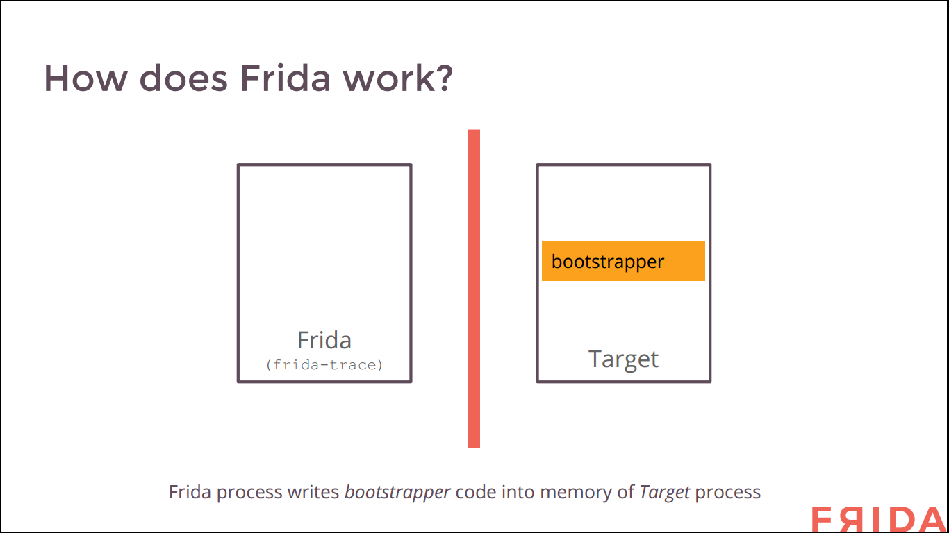

Slide 11
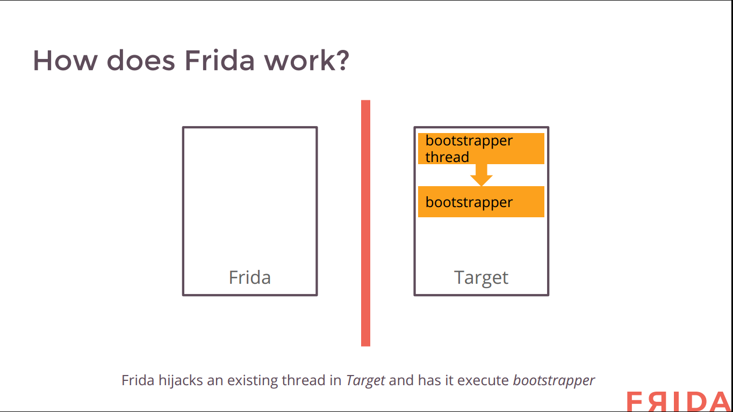

Slide 12
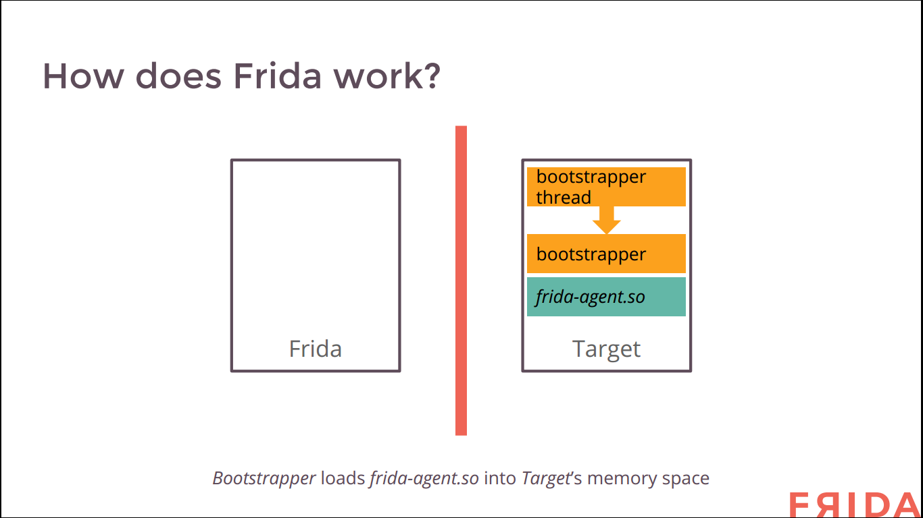

Slide 13
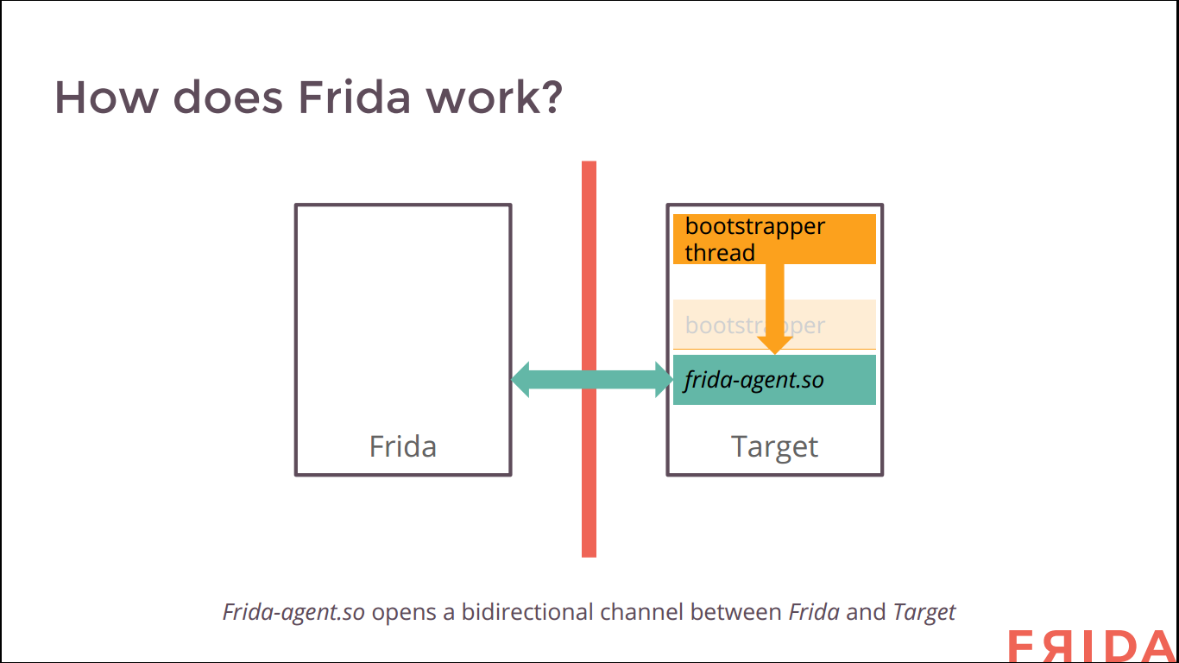

Slide 14
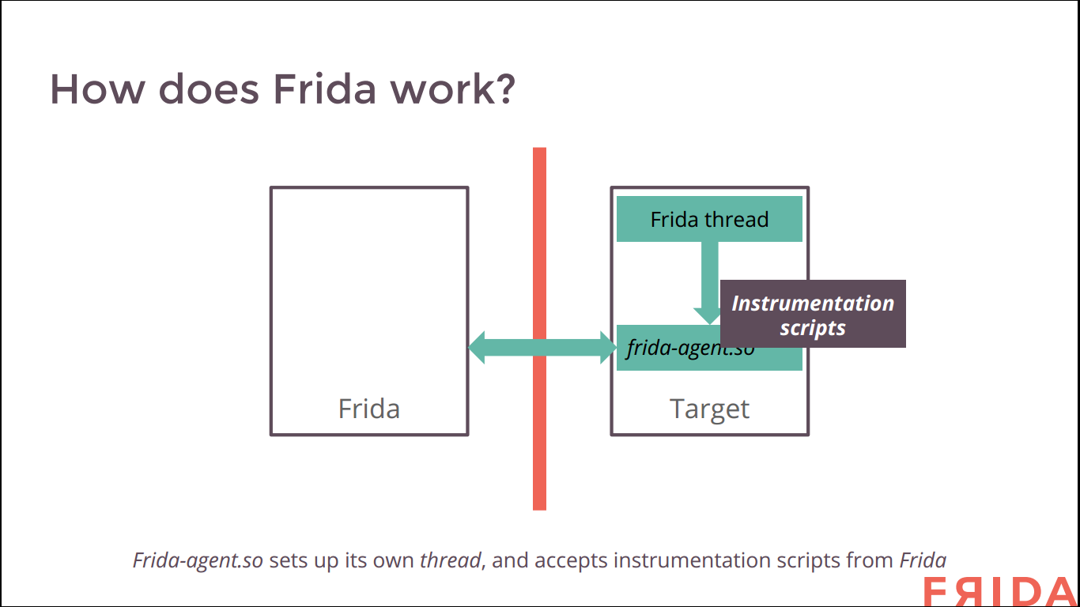

Slide 15
Install Frida (Python)
# python –m pip install Frida
Or
# pip install frida

Slide 16
Basics
Attach to process (locally, remotely)
Enumerate modules and threads
Check function call’s arguments
Modify arguments
Modify function

Slide 17
Bypassing Security Check
In Our Example:
Get Plaintext on Encryption Process
Brute Force PIN
Root Checking
SSL Pinning

Slide 18
Get Plaintext on Encryption Process
Concept: To produce a Ciphertext, an encryption process need a plaintext, key, and some other parameters such as Initialization vector.
Bypass: Hook the encryption function and log the plaintext data.

Slide 19
Brute Force PIN
Concept: A PIN or password protected binary need a function to compare user-input PIN with the correct one.
Bypass: Hook the checking and force it to return true.

Slide 20
Root Checking (Android, iOS)
Concept: Check the presence of several items as result or end of rooting process
Does binary SU exist?
Does apk Superuser exist?
Bypass: Hook the checking and force it to return true.

Slide 21
SSL Pinning
Concept: Use a local copy of x509 digital certificate to verify digital certificate provided by server.
Bypass: Hook the checking and force it to return true, regardless the value of provided certificate.

Slide 22
Alternative?
PIN:
https://software.intel.com/en-us/articles/pin-a-dynamic-binary-instrumentation-tool
DynamoRIO:
http://www.dynamorio.org/
In both cases, you write a code on top of those framework, compile them, and inject the library into the target.

